Slide 1




Dive into Open Source with GitHub and Git

Slide 2




Hi I am!
Priyanshi Rai
Final year student at University of Lucknow
GitHub Campus Expert
GDSC Lead’23
Product designer @datainfra
Community - Fork&Forge

Slide 3
Topic to be covered
What is Open Source?
Why Open Source and it’s requirement
What is git?
GitHub Overview
Basic Terminologies: Branching, Merging, Conflicts, Reverting, Staging area
Commands used in git
Handson of git on GitHub
GitHub Developers Student Pack

Slide 4








What is Open Source?
• Open source software is code that is designed to be publicly accessible.
• Open source software fosters open exchange, collaborative participation, transparency, and community-oriented development.
• Massive codebases are maintained by non-profit communities, allowing anyone with the required skills to contribute and engage with open source projects easily.

Slide 5



Real-World Examples
Python, an open source programming language, is widely used in various domains.
Python
WordPress
Linux
WordPress, a popular open source content management system, used to create stunning websites without coding knowledge.
Linux, an open source operating system, powers millions of devices worldwide and is renowned for its stability, security, and flexibility.

Slide 6

Why Open Source?
• Gain Experience working on a high-quality, large-scale, real-world projects.
• The only entry barrier is your own skill.
• Get Mentored and learn with world-class coders.
• Build your portfolio with proof of work (PRs).
• Earn cool swags, goodies and stickers ( ͡° ͜ʖ ͡°)
• Earn in $$$ spend in ₹₹₹
• Learn, collaborate, and network with global talent.

Slide 7
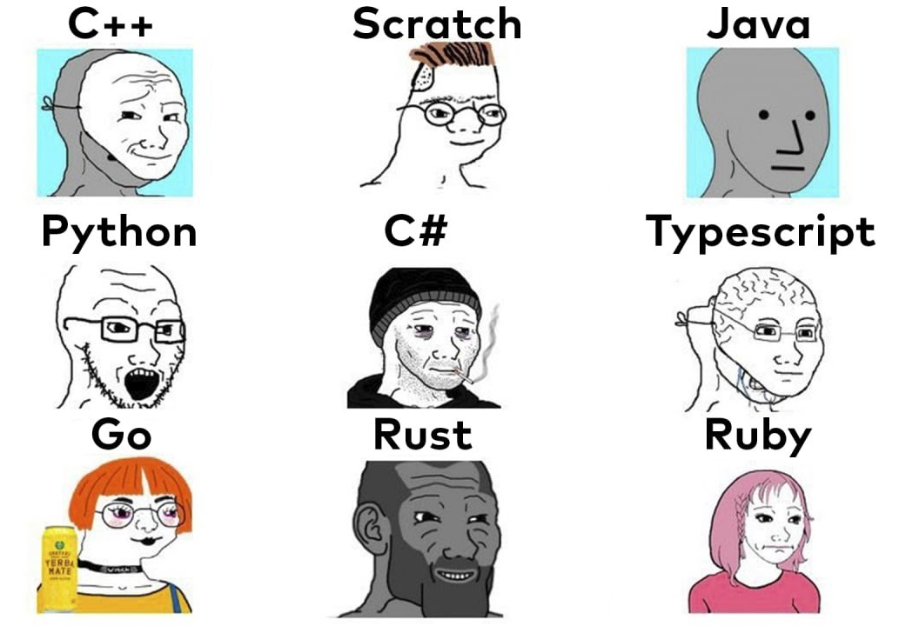
Requirements for Open Source
• Git & GitHub
• Basic - Intermediate programming skills in at least one popular programming language like Python, C, C++, HTML/CSS/JS, Java,Golang etc.
• Google-Fu: The ability to independently find and implement solutions to problems using documentation, and internet resources.

Slide 8




List of Open Source Programs
1
Google Summer of Code
Link | 3,000 USD stipend | 3 Month
Major League Hacking(MLH) Fellowship
3 lakh rupee stipend | 3 Month | Link
2
3
Hacktoberfest
Link | Offer swags | 1 Month
LFX Mentorship Program
$3000 USD stipend | 6 Month | Link
4

Slide 9

What is Git?
Git is a powerful version control system that you can use to manage your code.
Basically git is a command line tool that allow you to track changes over time, revert changes and also collaborate with other developers on the same files.

Slide 10
About
GitHub
GitHub is a platform that hosts billions of lines of code, and it’s where millions of developers gather every day to collaborate on and report issues with open source software.
It serves as a hub for version control, collaboration, and project management.
Version control allows developers to track changes, manage codebase history, and work together seamlessly.

Slide 11
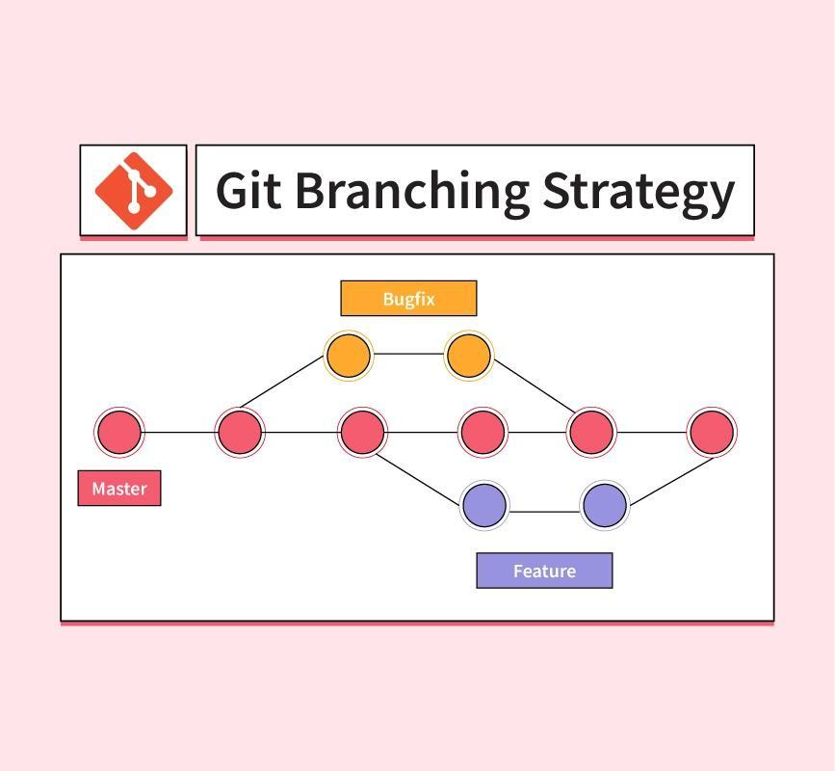
Repository
a repository is like a bag(storage) that contain all the files and folders related to a project cloned in our system. The repository keeps a record of all the versions we had.
Branching
Branching is like providing a separate room where one can create, update, and test your ideas without hindering the pre-existing project.

Slide 12
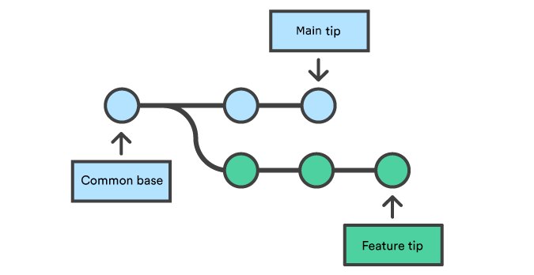
Merging
Merging means integrating two or more branches. It is a process of combining different versions of codes(files).
Merge conflict
Suppose a file has the same question but different answers edited simultaneously in different branches(by user A and user B).

Slide 13
LOCAL REPOSITORY
The local repository is present on our computer and consists of all the files and folders. This Repository is used to make changes locally, review history, and commit when offline.
REMOTE REPOSITORY
The remote repository refers to the server repository that may be present anywhere. This repository is used by all the team members to exchange the changes made.

Slide 14
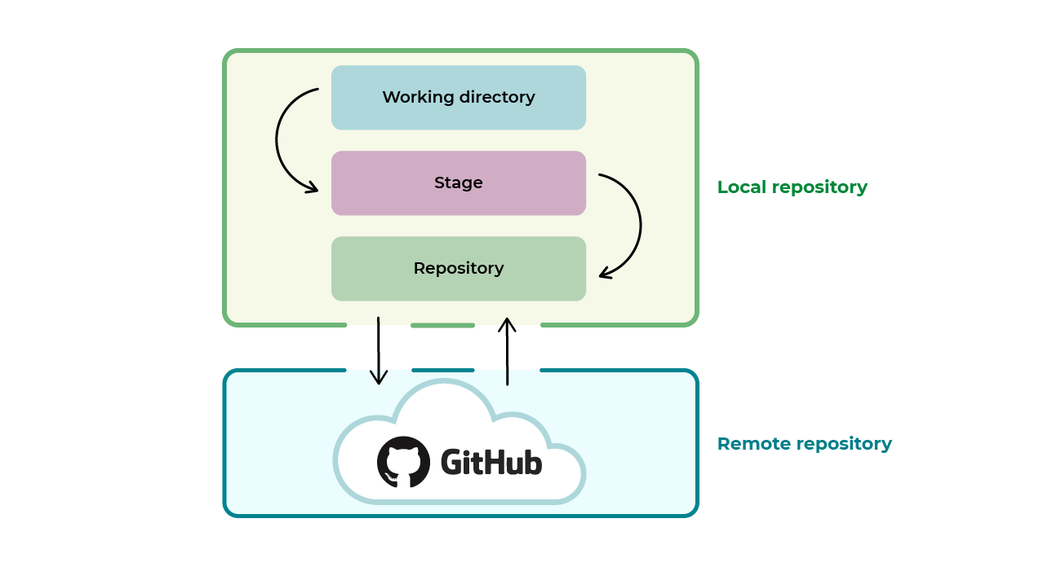

Slide 15


Slide 16
Git Commands

Slide 17

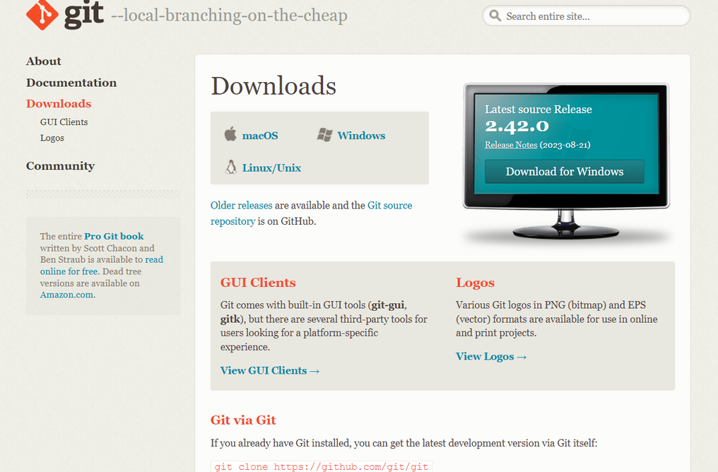
Download git
Link to download

Slide 18
First step
Check whether the git is downloaded in your system

Slide 19
git init
The command git init is used to create an empty Git repository.
git add .
Add command is used after checking the status of the files, to add those files to the staging area.
git commit -m “....”
The commit command makes sure that the changes are saved to the local repository.

Slide 20
git status
The git status command tells the current state of the repository. The command provides the current working branch.
git log
The git status command tells the history of all the changes.
git stash
Suppose we write some code and don’t want to commit it but save it somewhere for future use. Here we use stash command.

Slide 21
Let’s play on GitHub with git
CREATE A REPO

Slide 22
git clone <repo url>
The git clone command is used to create a local working copy of an existing remote repository.
git branch <branch name>
The git branch command is used to determine what branch the local repository is on.
git checkout <branch name>
The git checkout command is used to switch branches, whenever the work is to be started on a different branch.

Slide 23
git merge <branch name>
The git merge command is used to integrate the branches together. The command combines the changes from one branch to another branch.
git push origin main
The command git push is used to transfer the commits or pushing the content from the local repository to the remote repository.
git pull
The command "git pull origin master" copies all the files from the master branch of the remote repository to the local repository.

Slide 24
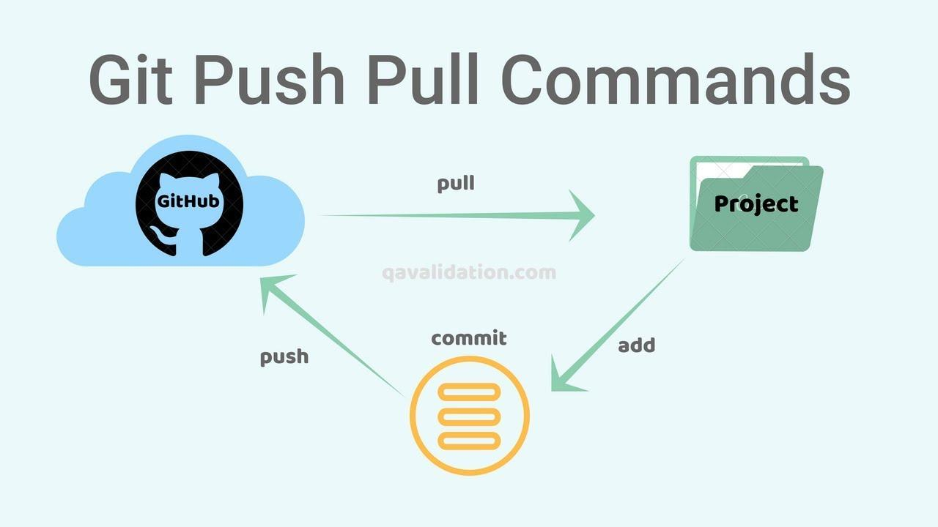

Slide 25

Summarising
First make the copy of project
git clone <URL>
git add .
git commit -m “.......”
git log
git push origin main
Create a pull Request

Slide 26


GitHub Developer Student Pack

Slide 27


Slide 28
Thank You!!

